Slide 1
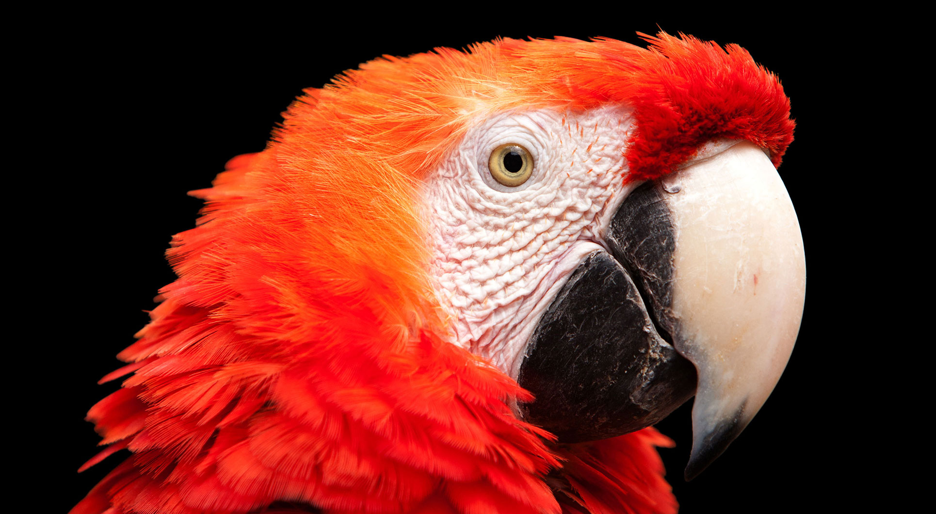
12.3 英雄排名榜单
《Python青少年趣味编程》
小牛叔出品

Slide 2
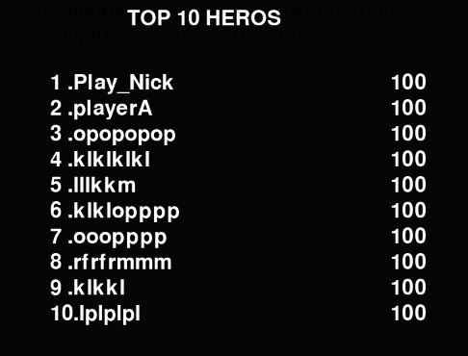
显示英雄榜

Slide 3
1、 如何读文件
def high_score(screen, score):
open('snake_top10.txt','a')
file = open('snake_top10.txt')
top10 =[]
for line in file.readlines():
top10.append((line[0:20],int(line[20:])))
file.close()
#如果分数比最后一名高
if score>= top10[-1][1] or len(top10)<10:
top10.insert(0,(('%-20s'%input_name(screen))[0:20], score))
top10.sort(key = lambda x:x[1],reverse=True)
if len(top10)>10:
top10 = top10[0:10]
return '\n'.join([ '%2d.'% (i+1) + x[0]+str(x[1]) for (i,x) in enumerate(top10)])

Slide 4
2、写文件
def high_score(screen, score):
open('snake_top10.txt','a').close()
file = open('snake_top10.txt','r+')
top10 =[]
for line in file.readlines():
top10.append((line[0:20],int(line[20:])))
#如果分数比最后一名高
if score>= top10[-1][1] or len(top10)<10:
top10.insert(0,(('%-20s'%input_name(screen))[0:20], score))
top10.sort(key = lambda x:x[1],reverse=True)
if len(top10)>10:
top10 = top10[0:10]
file.seek(0)
fileContent = '\n'.join([ x[0]+str(x[1]) for x in top10])
file.write(fileContent)
file.close()
return top10

Slide 5
3、上拉效果动画
def show_top10(screen,score):
old_screen = screen.copy()
top10_bg = pygame.Surface((900,600),SRCALPHA)
top10_bg.fill(Color(0,0,0,50),None)
font = pygame.font.Font(None,48)
top10_bg.blit(font.render('TOP 10 HEROS',1,Color(255,255,255)),(300,20))
for (i,textLine) in enumerate(high_score(screen,score)):
top10_bg.blit(font.render('%-2d.'%(i+1) + textLine[0],1,Color(255,255,255)),(180,120 + i*40))
top10_bg.blit(font.render(str(textLine[1]),1, Color(255,255,255)),(710,120 + i*40))
y=600
clock = pygame.time.Clock()
while True:
clock.tick(30)
for eventType in pygame.event.get():
if eventType.type == QUIT:
sys.exit()
if eventType.type == KEYUP and y<=0:
return
screen.blit(top10_bg,(0,y))
pygame.display.update()
y-=20
if y<=0:
y=0

